Slide 1
<Context>
Universal Container & Packaging, LLC specializes in packaging, fulfilment and distribution, of virtually any type of retail and promotional merchandise, from customized packaging solutions and fulfilment to direct mail and promotional products
CRM has been upgraded with Salesforce Summer15 version. The platform provides new enhancements which can be leveraged to change CRM configuration with 2 objectives
Make the configuration simpler
Deploy new functionalities
Notes:
1

Slide 2
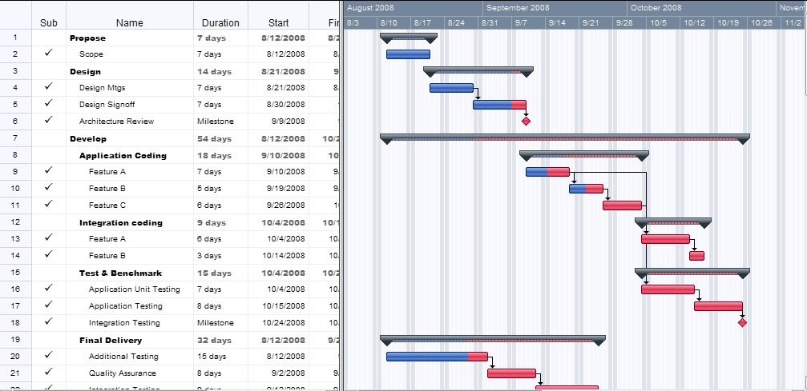

<Planning>

Slide 3
<Data Model>
User
Account
LastName
Email
OwnerId
- Account Owner
- Account Name
ParentId
AccountId
Opportunity
- Id

Slide 4
<Deliverables, Effort & Fields>
Deliverables
Unit testing | Doc
Visualforce Page VFP87 | Code
Visualforce Controller VFC87 | Code
Test Method | Code
Effort
Dev | 0,75 day
Config | 0 days
Doc | 0.25 days
Total | 1 day
Fields used for this development
Objects | Field label | Field name | Type
Account | Parent Account | ParentId | Reference (Account)
Account | Name | Name | String
Account | Owner | OwnerId | Reference (User)
User | Email | Email | Email
User | Last Name | Lastname | String

Slide 5
<Requirements>
From an omportunity, a button will call VF87 : the user will be able to select one and only one account in the accounts of the account hierarchy (from top to bottom)
For each account, the Account Name, Owner Last name and Owner email appears in the table
VF87 should take into account the visibility on records
On cancel, the user returns on previous page
On save, the user goes on the HOME tab
If an error occurs, it is displayed properly
Test coverage :
the test coverage should be above 95%
100% would be appreciated
If under 95%, reasons must be documented

Slide 6
<UI - Screenshot>
Please Choose an account you want the opportunity to be attached
 | Account Name | Owner Lastname | Owner Email
 | EDF | Smith | jsmith@example.com
 | EDF Idf | Smith | jsmith@example.com
 | EDF Boulogne | Smith | jsmith@example.com
X
SAVE
CANCEL
NB1 : colors are not important

Slide 7
<UI – Detail>
Limit to 1000 account only
Please Choose an account you want the opportunity to be attached
 | Account Name | Owner Lastname | Owner Email
 | EDF | Smith | jsmith@example.com
 | EDF Idf | Smith | jsmith@example.com
 | EDF Boulogne | Smith | jsmith@example.com
X
SAVE
CANCEL
Checkbox but only one can be selected
Attach the opportunity to this Account and go back on the Home tab
Do nothing and go back on the opportunity
NB1 : colors are not important

Slide 8
<Context and parameters>
The page is accessed from :
A button on the Opportunity detail page
The parameters provided to the page are :
retURL : where to go when the user cancel
saveURL : where to go when the user saves
Id : id of the current Opportunity

Slide 9
<Custom Labels>

Slide 10
<Unit Tests>

